Slide 1
Chapter 14: Bayesian Networks
These slides are adopted from Berkeley course materials and Russell and Norvig textbook

Slide 2


Independence
Two variables are independent if:
This says that their joint distribution factors into a product two simpler distributions
Another form:
We write:
Independence is a simplifying modeling assumption.

Slide 3



Example: Independence
Assume we have two random variables Temperature (hot/cold) and
weather (Sun/Rain). Are T and W independent?
P(T)P(W)
T | P
hot | 0.5
cold | 0.5
T | W | P
hot | sun | 0.4
hot | rain | 0.1
cold | sun | 0.2
cold | rain | 0.3
T | W | P
hot | sun | 0.3
hot | rain | 0.2
cold | sun | 0.3
cold | rain | 0.2
W | P
sun | 0.6
rain | 0.4

Slide 4


Example: Independence
N fair, independent coin flips:
H | 0.5
T | 0.5
H | 0.5
T | 0.5
H | 0.5
T | 0.5

Slide 5

Conditional Independence
Unconditional (absolute) independence very rare (why?)
Conditional independence is our most basic and robust form of knowledge about uncertain environments.
X is conditionally independent of Y given Z
if and only if:
or, equivalently, if and only if

Slide 6

Conditional Independence
P(Toothache, Cavity, Catch)
If I have a cavity, the probability that the probe catches in it doesn't depend on whether I have a toothache:
P(+catch | +toothache, +cavity) = P(+catch | +cavity)
The same independence holds if I don’t have a cavity:
P(+catch | +toothache, -cavity) = P(+catch| -cavity)
Catch is conditionally independent of Toothache given Cavity:
P(Catch | Toothache, Cavity) = P(Catch | Cavity)
Equivalent statements:
P(Toothache | Catch , Cavity) = P(Toothache | Cavity)
P(Toothache, Catch | Cavity) = P(Toothache | Cavity) P(Catch | Cavity)
One can be derived from the other easily

Slide 7


Conditional Independence
What about this domain:
Traffic (T)
Umbrella (U)
Raining (R)
T U | R

Slide 8
Probabilistic Models
Models describe how (a portion of) the world works
Models are always simplifications
May not account for every variable
May not account for all interactions between variables
What do we do with probabilistic models?
We (or our agents) need to reason about unknown variables, given evidence
Example: explanation (diagnostic reasoning)
Example: prediction (causal reasoning)

Slide 9
Bayesian Networks
The full joint probability distribution can answer any question about the domain, but this can become intractably large as the number of variables grows
Bayesian networks represent the dependencies among variables.
Bayesian networks can represent essentially any full joint probability distribution.

Slide 10
Bayesian Networks
A Bayesian network is a directed acyclic graph (DAG) in which each node is annotated with quantitative probability information.
The full specification is as follows:
1. Each node corresponds to a random variable, which may be discrete or continuous.
2. A set of directed links or arrows connects pairs of nodes. If there is an arrow from node
X to node Y , X is said to be a parent of Y.
3. Each node Xi has a conditional probability distribution P(Xi |Parents(Xi)) that quantifies
the effect of the parents on the node.

Slide 11
Bayesian Networks
The topology of the network—the set of nodes and links—specifies the conditional independence relationships that hold in the domain, in a way that will be made precise shortly.
The intuitive meaning of an arrow is typically that X has a direct influence on Y, which suggests
that causes should be parents of effects.
Given the Bayesian network topology and the conditional probability tables, the full joint distribution for all the variables can be specified.

Slide 12
Example Bayesian Network: Car

Slide 13

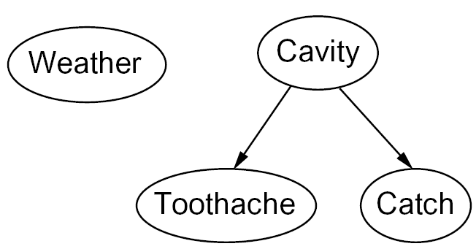
Graphical Model Notation
Nodes: variables (with domains)
Can be assigned (observed) or unassigned (unobserved).
Arcs: interactions
Similar to CSP constraints
Indicate “direct influence” between variables
Formally: encode conditional independence

Slide 14
Example: Coin Flips
N independent coin flips
No interactions between variables: absolute independence
X₁
X₂
X_{n}

Slide 15
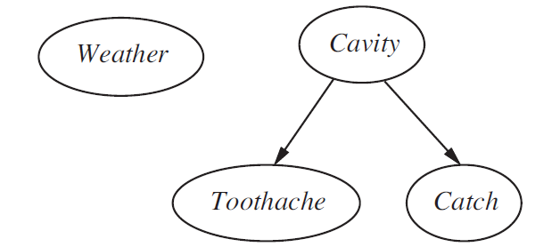
Bayesian Network Example
Toothache and Catch are conditionally independent given Cavity.
Weather is independent of the other variables.

Slide 16
Example: Burglary Network
You have a new burglar alarm installed at home. It is fairly reliable at detecting a burglary, but also responds on occasion to minor earthquakes.
You also have two neighbors, John and Mary, who have promised to call you at work when they hear the alarm.
John nearly always calls when he hears the alarm, but sometimes confuses the telephone ringing with the alarm and calls then, too.
Mary, on the other hand, likes rather loud music and often misses the alarm altogether. Given the evidence of who has or has not called, we would like to estimate the probability of a burglary.
Draw the corresponding Bayesian Network.

Slide 17
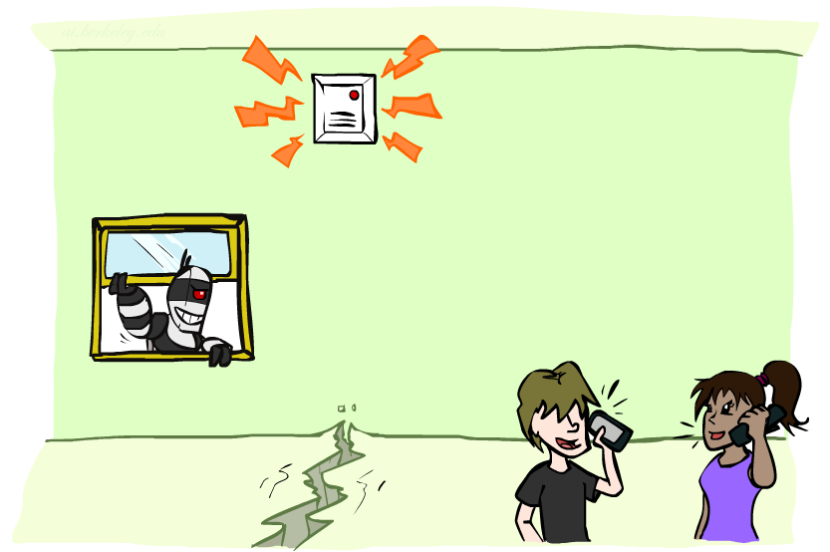
Example: Burglary Network
Variables
B: Burglary
A: Alarm goes off
M: Mary calls
J: John calls
E: Earthquake!

Slide 18
Example: Burglary Network
Variables
B: Burglary
A: Alarm goes off
M: Mary calls
J: John calls
E: Earthquake!
Burglary
Earthquake
Alarm
John calls
Mary calls

Slide 19
Example: Burglary Network
The network structure shows that burglary and earthquakes directly affect the probability of the alarm’s going off, but whether John and Mary call depends only on the alarm.
The network thus represents our assumptions that they do not perceive burglaries directly, they do not notice minor earthquakes, and they do not confer before calling.

Slide 20
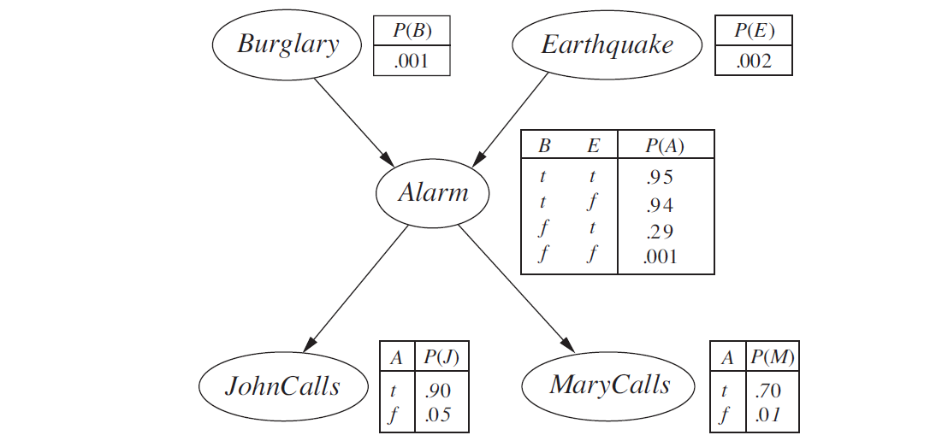

Example: Burglary Network
Notes:
demo

Slide 21
Conditional Probability Table (CPT)
Each row in a CPT contains the conditional probability of each node value for a conditioning case.
A conditioning case is just a possible combination of values for the parent nodes.
Each row must sum to 1, because the entries represent an exhaustive set of cases for the variable.
For Boolean variables, once you know that the probability of a true value is p, the probability of false must be 1 – p, so we the second number is often omitted.
A table for a Boolean variable with k Boolean parents contains 2^{k} independently specifiable probabilities.
A node with no parents has only one row, representing the prior probabilities of each possible value of the variable.

Slide 22


Bayesian Network Semantics
Bayesian network is a directed acyclic graph.
It consists of a set of nodes, one per variable X
A conditional distribution for each node
A collection of distributions over X, one for each combination of parents’ values
CPT: conditional probability table
Description of a noisy “causal” process
A₁
A_{n}
X
A Bayes network = Topology (graph) + Local Conditional Probabilities

Slide 23

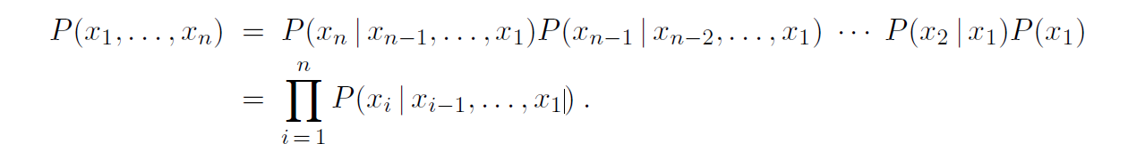
Joint Probability Distribution
The joint probability distribution for any N variables X₁,X₂,….X_{N}:
This can be written as:
The rule above is named the chain rule.
The chain rule holds for any set of random variables.

Slide 24
Bayesian Network Semantics
What do Bayesian networks mean?
Bayesian networks is a representation of joint distributions.
The chain rule which hold for any set of variables state that:
However, for Bayesian networks, using the conditional independence:

Slide 25



Bayesian Network Semantics
Bayesian networks implicitly encode joint distributions.
As a product of local conditional distributions
To see what probability a BN gives to a full assignment, multiply all the relevant conditionals together:
Not every BN can represent every joint distribution
The topology enforces certain conditional independencies

Slide 26

Conditional Independence and the Chain Rule
Chain rule:
Example:
With assumption of conditional independence:
Bayesian networks / graphical models help us express conditional independence assumptions.

Slide 27



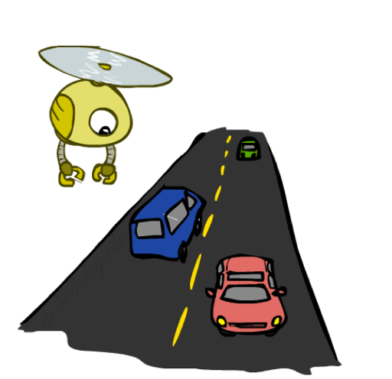
Example: Traffic
R
+r | 1/4
-r | 3/4
P(+r)P(-t|+r) = ¼*1/4
+r | +t | 3/4
 | -t | 1/4
T
-r | +t | 1/2
 | -t | 1/2
Notes:
demo

Slide 28
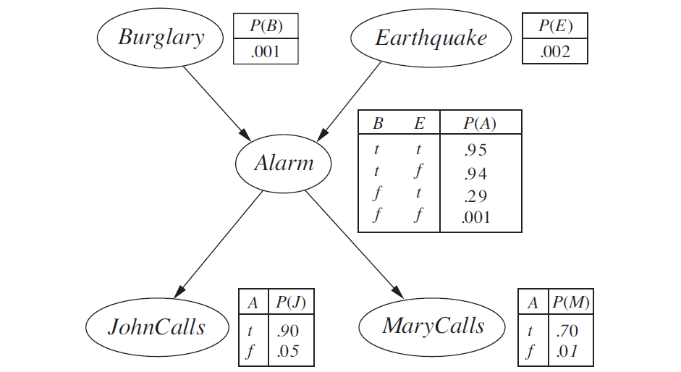

Example: Burglary Network
Given this Bayesian network, calculate P(j,m,a, $\text{￢}$b, $\text{￢}$e)

Slide 29
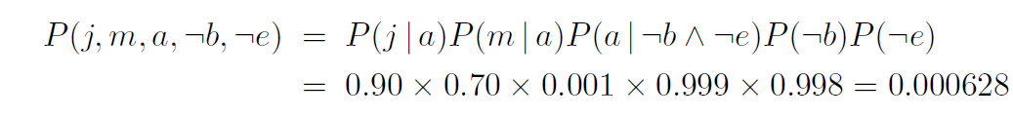
Example: Burglary Network

Slide 30
Bayesian Networks Construction
1. Nodes:
Determine the set of variables that are required to model the domain, and order them, {X1, . .,Xn}.
Any order will work, but the resulting network will be more compact if the variables are ordered such that causes precede effects.
2. Links:
For i = 1 to n do:
• Choose, from X1, . . . ,Xi−1, a minimal set of parents for Xi, such that the following equation is satisfied:
For each parent insert a link from the parent to Xi.
• CPTs: Write down the conditional probability table, P(Xi|Parents(Xi)).
Intuitively, the parents of node Xi should contain all those nodes in X1, . . . , Xi−1 that directly influence Xi.

Slide 31
Bayesian Networks Construction
Because each node is connected only to earlier nodes, this construction method guarantees
that the network is acyclic.
Bayesian networks contain no redundant probability values, therefore there is no chance for inconsistency between probability values.

Slide 32
Bayesian Networks Compactness
Bayesian Networks is locally structured sparse) system where each subcomponent interacts directly with only a bounded number of other components, regardless of the total number of components.
Local structure is usually associated with linear rather than exponential growth in complexity.
For Bayesian networks, assume each random variable is directly influenced by at most k others (has k parents), for some constant k.
If we assume n Boolean variables, then the amount of information needed to specify each conditional probability table will be at most 2^{k} numbers, and the complete network can be specified by n2^{k} numbers.
In contrast, the joint distribution contains 2^{n} numbers.
For example, suppose we have n=30 nodes, each with five parents (k =5).
Then, the Bayesian network requires 960 numbers, but the full joint distribution requires over a billion

Slide 33
Exact Inference in Bayesian Networks
Any probabilistic inference system computes the posterior probability distribution for a set of query variables, given some observed event(some assignment of values to a set of evidence variables).
X denotes the query variable.
E denotes the set of evidence variables E1, . . . ,Em, and e is a particular observed event.
Y denotes the hidden variables which are nonevidence, nonquery variables Y1, . . . , Yl.
Thus, the complete set of variables is X ∪E ∪Y.
A typical query asks for the posterior probability distribution P(X | e)

Slide 34
Exact Inference in Bayesian Networks- Example
In the burglary network, we might observe the event in which JohnCalls =true and
MaryCalls =true.
Calculate the probability that a burglary has occurred
given than Mary calls and John calls.
P(b|j,m)=?

Slide 35


Inference by enumeration
Any conditional probability can be computed by summing terms from the full joint distribution as follows:
P(Burglary | JohnCalls =true, MaryCalls =true).
The hidden variables for this query are Earthquake and Alarm:
(Using Bayes rule and Marginalization)

Slide 36

Inference by enumeration
For Burglary=True:
To compute this expression, we have to add four terms, each computed by multiplying five numbers.
In the worst case, where we have to sum out almost all the variables, the complexity
of the algorithm for a network with n Boolean variables is O(n2^{n}).

Slide 37

Inference by enumeration
A simple improvement can de done by taking out P(b) and P(e) out of the summations:

Slide 38
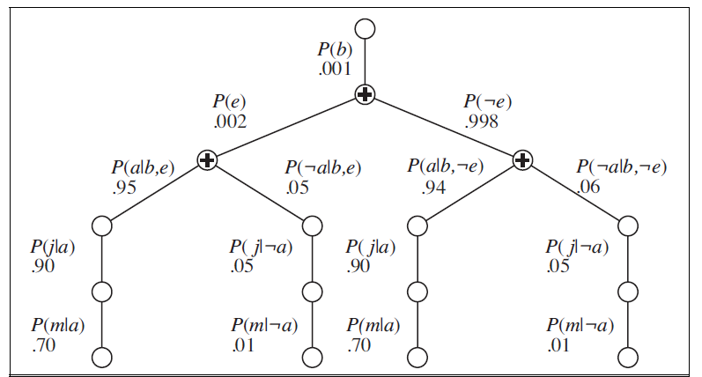
Inference by enumeration
The structure of computations done by inference by enumeration:
Repeated Computations!

Slide 39
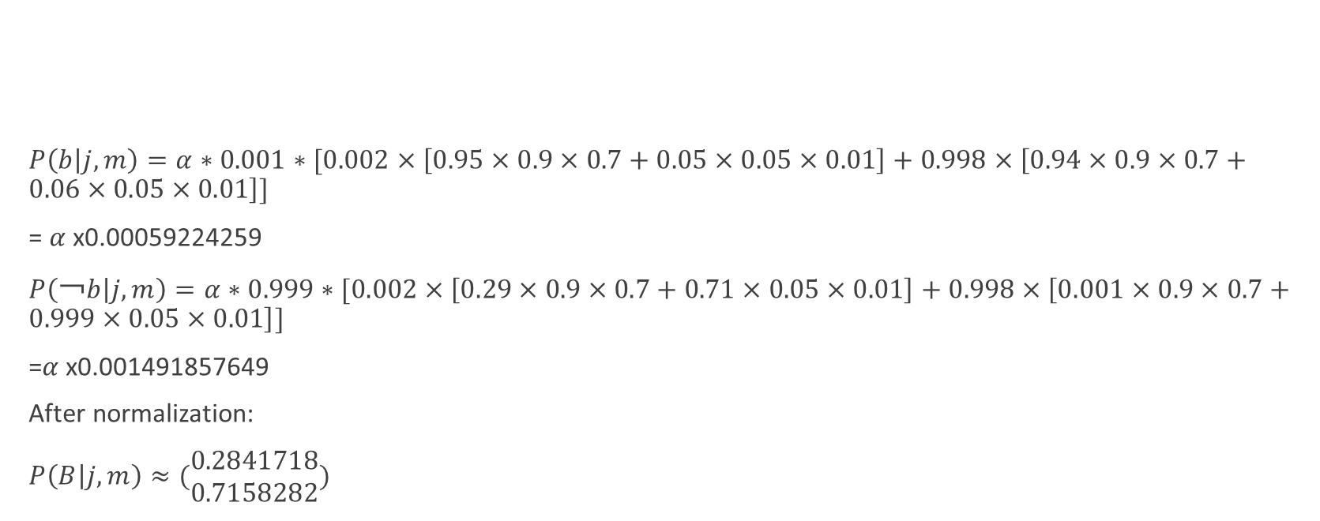
Inference by enumeration Example
$P\left(b | j,m\right)=α∗0.001∗[0.002×\left[0.95×0.9×0.7+0.05×0.05×0.01\right]+0.998×\left[0.94×0.9×0.7+0.06×0.05×0.01\right]]$
= $α$x0.00059224259
$P\left(\text{￢}b | j,m\right)=α∗0.999∗[0.002×\left[0.29×0.9×0.7+0.71×0.05×0.01\right]+0.998×\left[0.001×0.9×0.7+0.999×0.05×0.01\right]]$
=$α$x0.001491857649
After normalization:
$P\left(B | j,m\right)≈(\begin{matrix}0.2841718 \\ 0.7158282\end{matrix})$

Slide 40
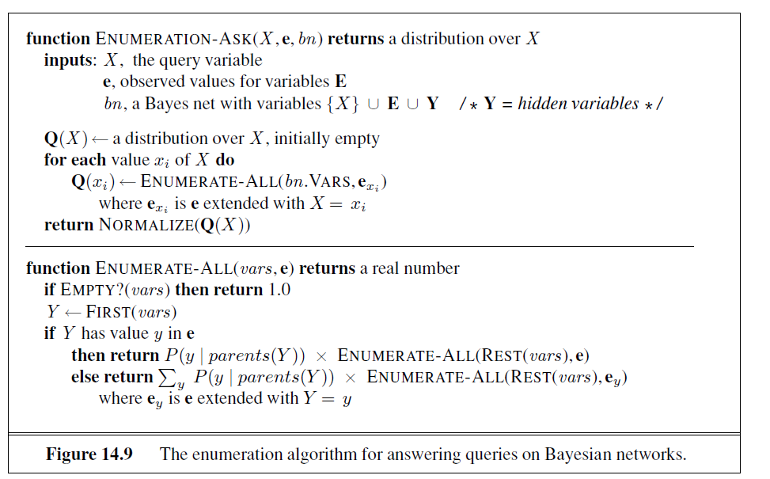
Inference by enumeration

Slide 41
Inference by enumeration
The ENUMERATION-ASK algorithm evaluates the computation trees using depth-first recursion.
The algorithm is very similar to the backtracking algorithm for solving CSPs.
The space complexity of ENUMERATION-ASK is linear in the number of variables.
However, its time complexity for a network with n Boolean variables is always O(2^{n})—
better than the O(n 2^{n}) for the simple approach described earlier.
Inference by enumeration repeats evaluating some expressions such as
the products P(j | a)P(m| a) and P(j | ￢a)P(m| ￢a) are computed twice, once for each value of e.

Slide 42
The Variable Elimination Algorithm
The enumeration algorithm can be improved substantially by eliminating repeated calculations.
Repeated Computations!
Dynamic Programming can help reduce the needed computations by storing repeated computations.

Slide 43
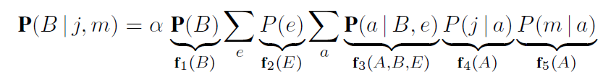
The Variable Elimination Algorithm
Variable elimination works by evaluating expressions in right-to-left order.
Intermediate results are stored, and summations over each variable are done only for those portions of the expression that depend on the variable.

Slide 44

The Variable Elimination Algorithm
$f_{3}(A,B,E)$ will be a 2×2×2 matrix (tensor).
The operator $“×”$ is the point-wise product (not the normal matrix multiplication).

Slide 45



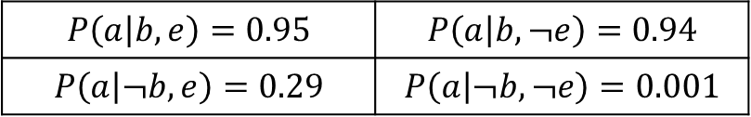



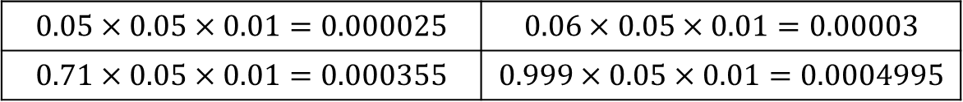
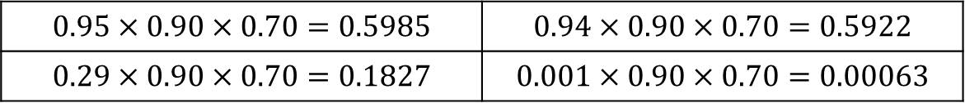



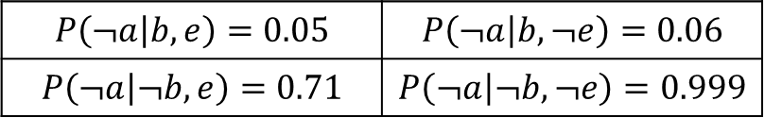







Example
$$E$$
$f_{3}(A,B,E)$
$f_{4}(A)$
$f_{5}(A)$
$$P\left(a | b,e\right)=0.95$$ | $$P\left(a | b,¬e\right)=0.94$$
$$P\left(a | ¬b,e\right)=0.29$$ | $$P\left(a | ¬b,¬e\right)=0.001$$
$$B$$
$$P\left(j | a\right)=0.90$$
$$P\left(m | a\right)=0.70$$
$$P\left(¬a | b,e\right)=0.05$$ | $$P\left(¬a | b,¬e\right)=0.06$$
$$P\left(¬a | ¬b,e\right)=0.71$$ | $$P\left(¬a | ¬b,¬e\right)=0.999$$
$$A$$
$$P\left(j | ¬a\right)=0.05$$
$$A$$
$$P\left(m | ¬a\right)=0.01$$
$$A$$
$$f_{3}(A,B,E)×f_{4}(A)×f_{5}(A)$$
$$E$$
$$0.95×0.90×0.70=0.5985$$ | $$0.94×0.90×0.70=0.5922$$
$$0.29×0.90×0.70=0.1827$$ | $$0.001×0.90×0.70=0.00063$$
$$B$$
$$0.05×0.05×0.01=0.000025$$ | $$0.06×0.05×0.01=0.00003$$
$$0.71×0.05×0.01=0.000355$$ | $$0.999×0.05×0.01=0.0004995$$
$$A$$

Slide 46







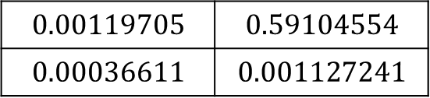




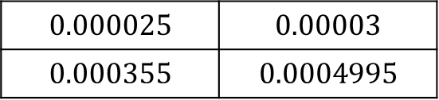

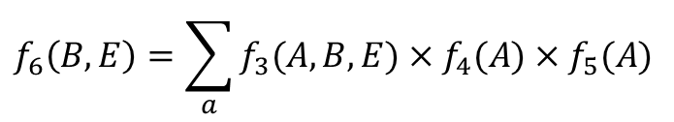

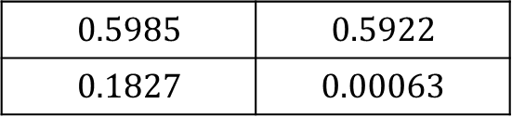
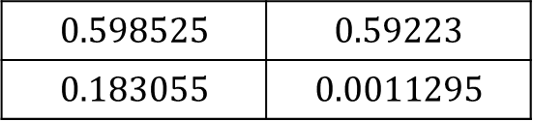

Example
$$f_{6}\left(B,E\right)$$
$$f_{3}(A,B,E)×f_{4}(A)×f_{5}(A)$$
$$E$$
$$f_{6}\left(B,E\right)=\sum_{a}{f_{3}(A,B,E)×f_{4}(A)×f_{5}(A)}$$
$$0.5985$$ | $$0.5922$$
$$0.1827$$ | $$0.00063$$
$$B$$
$$E$$
$$0.598525$$ | $$0.59223$$
$$0.183055$$ | $$0.0011295$$
$$+$$
$$B$$
$$0.000025$$ | $$0.00003$$
$$0.000355$$ | $$0.0004995$$
$$A$$
$$f_{2}(E)×f_{6}\left(B,E\right)$$
$$E$$
$$f_{2}(E)$$
$$0.00119705$$ | $$0.59104554$$
$$0.00036611$$ | $$0.001127241$$
$$E$$
$$B$$
$$P\left(e\right)=0.002$$ | $$P\left(¬e\right)=0.998$$

Slide 47




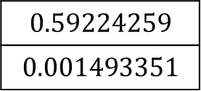

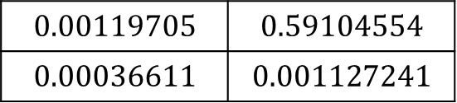

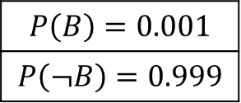

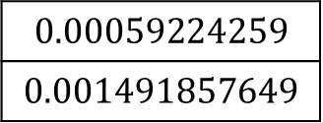
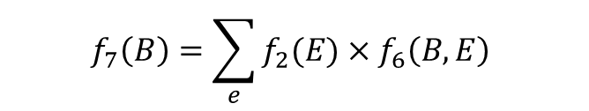



Example
$$f_{7}\left(B\right)$$
$$f_{6}\left(B,E\right)$$
$$f_{2}(E)×f_{6}\left(B,E\right)$$
$$E$$
$$0.00119705$$ | $$0.59104554$$
$$0.00036611$$ | $$0.001127241$$
$$B$$
$$+$$
$$f_{1}(B)$$
$$f_{1}(B)×f_{7}\left(B\right)$$
$$0.59224259$$
$$0.001493351$$
$$P\left(B\right)=0.001$$
$$P\left(¬B\right)=0.999$$
$$0.00059224259$$
$$0.001491857649$$
$$B$$
$$B$$
$$B$$
$$f_{7}\left(B\right)=\sum_{e}{f_{2}(E)×f_{6}\left(B,E\right)}$$

Slide 48

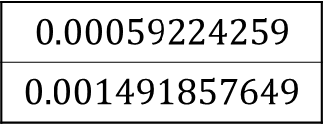
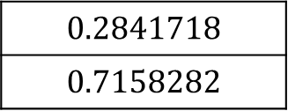




Example
$$f_{7}\left(B\right)$$
$$f_{6}\left(B,E\right)$$
$$f_{1}(B)×f_{7}\left(B\right)$$
$$0.00059224259$$
$$0.001491857649$$
$$α=\frac{1}{0.00059224259+0.001491857649}=\frac{1}{0.002084100239}$$
$$B$$
$$P\left(B | j,m\right)=αf_{1}(B)×f_{7}\left(B\right)$$
$$0.2841718$$
$$0.7158282$$
$$P\left(b | j,m\right)=0.2841718$$
$$P\left(¬b | j,m\right)=0.7158282$$
$$B$$

Slide 49
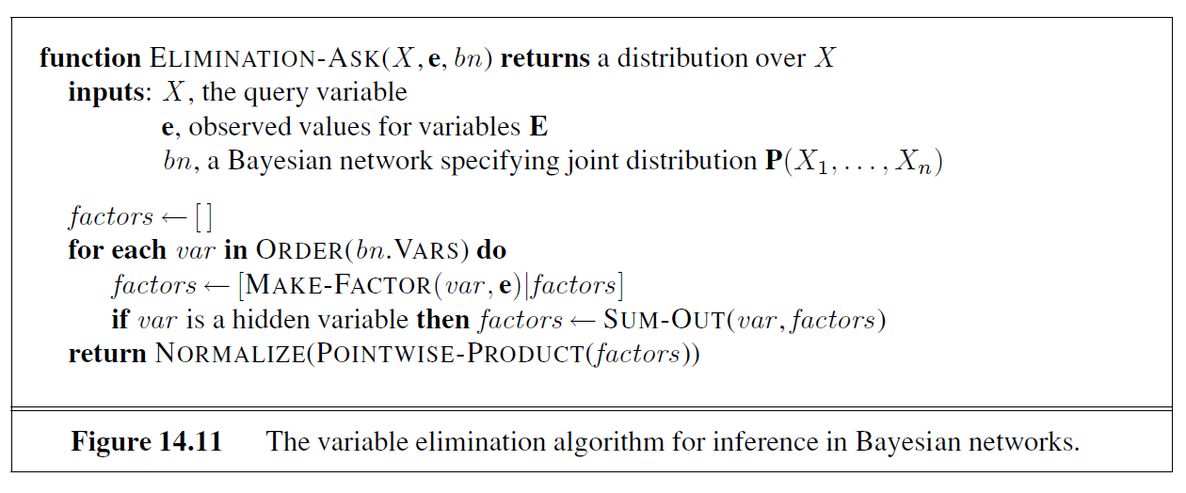
The Variable Elimination Algorithm

Slide 50
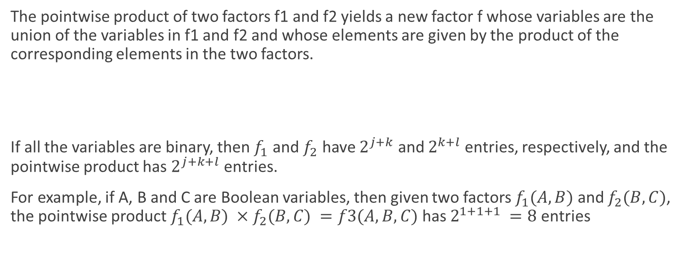
Operations on Factors
The pointwise product of two factors f1 and f2 yields a new factor f whose variables are the union of the variables in f1 and f2 and whose elements are given by the product of the corresponding elements in the two factors.
If all the variables are binary, then $f_{1}$ and $f_{2}$ have $2^{j+k}$ and $2^{k+l}$ entries, respectively, and the pointwise product has $2^{j+k+l}$ entries.
For example, if A, B and C are Boolean variables, then given two factors $f_{1}(A,B)$ and $f_{2}(B,C)$, the pointwise product $f_{1}(A,B) ×f_{2}(B,C) =f3(A,B,C)$has $2^{1+1+1} =8$ entries

Slide 51

Operations on Factors
Summing out a variable from a product of factors is done by adding up the submatrices formed by fixing the variable to each of its values in turn.

Slide 52
Variable ordering and variable relevance
The algorithm includes an unspecified ORDER function to choose an ordering for the variables. Every choice of ordering yields a valid algorithm, but different orderings cause different intermediate factors to be generated during the calculation.
For example, in the calculation shown previously, we eliminated A before E.
if we do it the other way, the calculation becomes

Slide 53
Variable ordering and variable relevance
In general, the time and space requirements of variable elimination are dominated by the size of the largest factor constructed during the operation of the algorithm.
This in turn is determined by the order of elimination of variables and by the structure of the network.
It turns out to be intractable to determine the optimal ordering, but several good heuristics are available.
One fairly effective method is a greedy one: eliminate whichever variable minimizes the size of the next factor to be constructed.

Slide 54
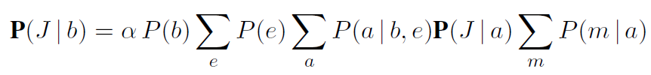
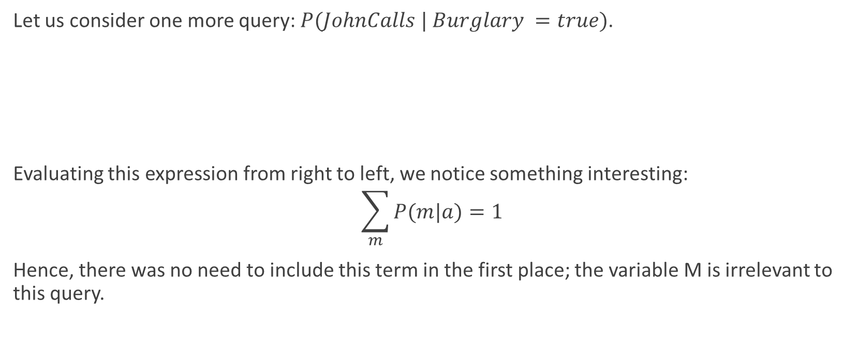
Variable ordering and variable relevance
Let us consider one more query: $P(JohnCalls | Burglary =true)$.
Evaluating this expression from right to left, we notice something interesting:
$$\sum_{m}{P(m|a)}=1$$
Hence, there was no need to include this term in the first place; the variable M is irrelevant to this query.

Slide 55
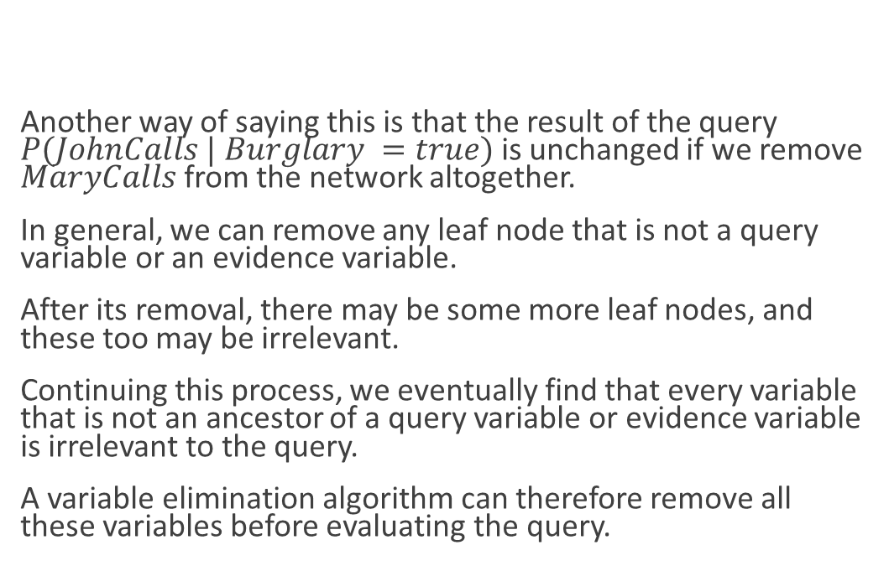
Variable ordering and variable relevance
Another way of saying this is that the result of the query $P(JohnCalls | Burglary =true)$ is unchanged if we remove $MaryCalls$ from the network altogether.
In general, we can remove any leaf node that is not a query variable or an evidence variable.
After its removal, there may be some more leaf nodes, and these too may be irrelevant.
Continuing this process, we eventually find that every variable that is not an ancestor of a query variable or evidence variable is irrelevant to the query.
A variable elimination algorithm can therefore remove all these variables before evaluating the query.
Evidence
Query
A Leaf Node that is neither a Query or an Evidence Variable

Slide 56
Complexity of Variable Elimination
The complexity of exact inference in Bayesian networks depends strongly on the structure of the network:
For polytrees (also known as singly connected networks where there is at most one undirected path between any two nodes in the network), the time and space complexity of exact inference is linear in the size of the network.
For multiply connected networks, variable elimination can have exponential time and space complexity in the worst case, even when the number of parents per node is bounded.

Slide 57
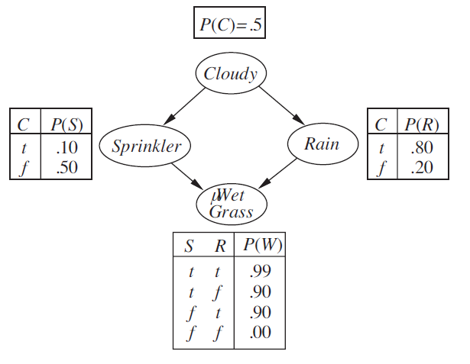
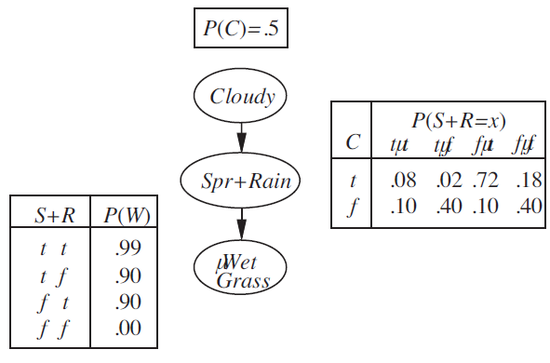
Complexity of Variable Elimination
Meganode
A polytree generated by clustering (Sprinkler and Rain) in the multiply connected network
A single connected network
(Polytree)
A multiply connected network

Slide 58
References
Sections 14.1., 14.2, and 14.4.

